Slide 1

Regularization – L1, L2 and Elastic Net
EMPOWERING High Performance Technology Teams

Slide 2
OVERVIEW

Slide 3
Overview
Total Sessions (2 hours)
Focus majorly on Regularization
Covering Bias-Variance trade-off, Regularization, Ridge, Lasso and Elastic Net

Slide 4
Agenda
The Bias-Variance trade-off
Overfitting and Underfitting
Regularization
Lasso Regression
Ridge Regression
Elastic Net Regression

Slide 5


The Bias-Variance Trade-Off
What is “Bias”?
Difference between the model’s predicted value and the actual value
What is “Variance”?
The measure of spread of data from its mean
Notes:
Image Source link: https://www.geeksforgeeks.org/bias-vs-variance-in-machine-learning/
Instructor notes:
There are various ways to evaluate a machine-learning model. We can use MSE (Mean Squared Error) for Regression; Precision, Recall, and ROC (Receiver of Characteristics) for a Classification Problem along with Absolute Error. In a similar way, Bias and Variance help us in parameter tuning and deciding better-fitted models among several built.
There are two types of error in ML. Reducible error and Irreducible error. Bias and Variance come under reducible error. Irreducible error is noise.
What is Bias?
Bias is simply defined as the inability of the model because of that there is some difference or error occurring between the model’s predicted value and the actual value. These differences between actual or expected values and the predicted values are known as error or bias error or error due to bias. Bias is a systematic error that occurs due to wrong assumptions in the machine learning process.
Low Bias: Low bias value means fewer assumptions are taken to build the target function. In this case, the model will closely match the training dataset.
High Bias: High bias value means more assumptions are taken to build the target function. In this case, the model will not match the training dataset closely.
Let Y be the true value of a parameter, and let Ycap be an estimator of Y based on a sample of data. Then, the bias of the estimator bias(Ycap) is given by the formula. where E(Ycap) is the expected value of the estimator Ycap . It is the measurement of the model that how well it fits the data.
What is Variance?
Variance is the measure of spread in data from its mean position. In machine learning variance is the amount by which the performance of a predictive model changes when it is trained on different subsets of the training data. More specifically, variance is the variability of the model that how much it is sensitive to another subset of the training dataset. i.e. how much it can adjust on the new subset of the training dataset.
Low variance: Low variance means that the model is less sensitive to changes in the training data and can produce consistent estimates of the target function with different subsets of data from the same distribution.
High variance: High variance means that the model is very sensitive to changes in the training data and can result in significant changes in the estimate of the target function when trained on different subsets of data from the same distribution.
Let Y be the actual values of the target variable, and Ycap be the predicted values of the target variable. Then the variance of a model can be measured as the expected value of the square of the difference between predicted values and the expected value of the predicted values as shown in the formula. Where E[Y-bar] is the expected value of the predicted values. Here expected value is averaged over all the training data.

Slide 6
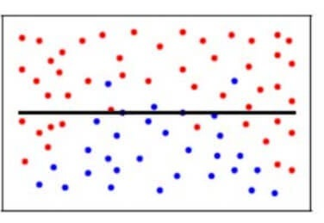
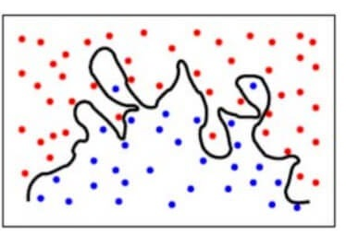
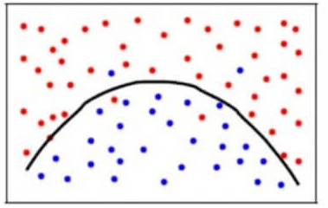
The Bias-Variance Trade-Off
Notes:
Image Source link: https://www.analyticsvidhya.com/blog/2020/08/bias-and-variance-tradeoff-machine-learning/
Instructor notes:
Top-left – high Bias error
Top-right – high Variance error
To achieve a balance between the Bias error and the Variance error, we need a value of k such that the model neither learns from the noise (overfit on data) nor makes sweeping assumptions on the data(underfit on data). To keep it simpler, a balanced model would look like this – bottom picture
Though some points are classified incorrectly, the model generally fits most of the datapoints accurately. The balance between the Bias error and the Variance error is the Bias-Variance Tradeoff.

Slide 7
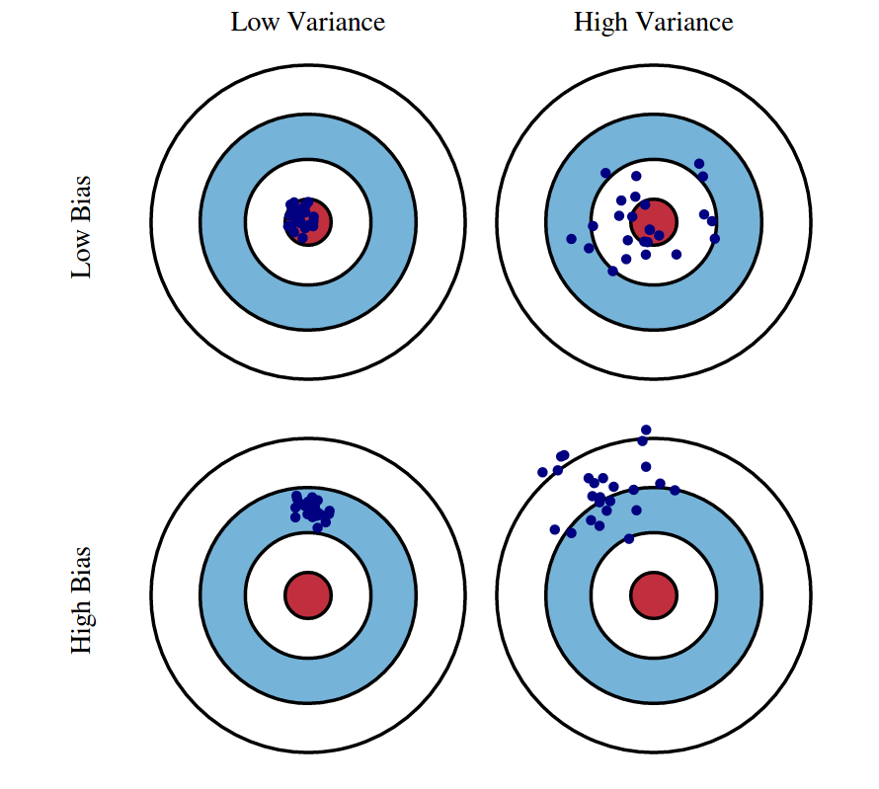
Overfitting And Underfitting
Notes:
Image Source link: https://www.cs.cornell.edu/courses/cs4780/2018fa/lectures/lecturenote12.html
Instructor notes:
There can be four combinations between bias and variance.
High Bias, Low Variance: A model with high bias and low variance is said to be underfitting.
High Variance, Low Bias: A model with high variance and low bias is said to be overfitting.
High-Bias, High-Variance: A model has both high bias and high variance, which means that the model is not able to capture the underlying patterns in the data (high bias) and is also too sensitive to changes in the training data (high variance). As a result, the model will produce inconsistent and inaccurate predictions on average.
Low Bias, Low Variance: A model that has low bias and low variance means that the model is able to capture the underlying patterns in the data (low bias) and is not too sensitive to changes in the training data (low variance). This is the ideal scenario for a machine learning model, as it is able to generalize well to new, unseen data and produce consistent and accurate predictions. But in practice, it’s not possible.
Linear Regression is a high-bias model.

Slide 8
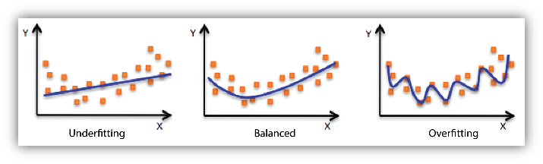
Overfitting And Underfitting
Notes:
Image Source link: https://docs.aws.amazon.com/machine-learning/latest/dg/model-fit-underfitting-vs-overfitting.html
Instructor notes:
Underfitting refers to a model that can neither model the training data nor generalize to new data.
An underfit machine learning model is not a suitable model and will be obvious as it will have poor performance on the training data.
Underfitting is often not discussed as it is easy to detect given a good performance metric. The remedy is to move on and try alternate machine learning algorithms. Nevertheless, it does provide a good contrast to the problem of overfitting.
Overfitting refers to a model that models the training data too well.
Overfitting happens when a model learns the detail and noise in the training data to the extent that it negatively impacts the performance of the model on new data. This means that the noise or random fluctuations in the training data is picked up and learned as concepts by the model. The problem is that these concepts do not apply to new data and negatively impact the models ability to generalize.
Overfitting: Good performance on the training data, poor generliazation to other data.
Underfitting: Poor performance on the training data and poor generalization to other data

Slide 9
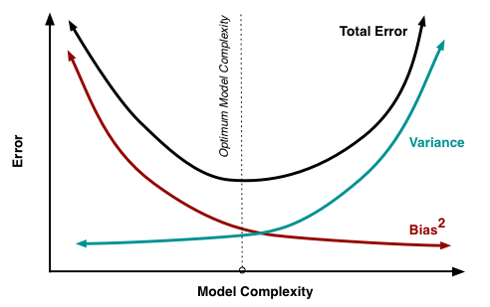
Optimum Model
Notes:
Image Source link: https://www.cs.cornell.edu/courses/cs4780/2018fa/lectures/lecturenote12.html
Instructor notes:
In terms of model complexity, we can use the following diagram to decide on the optimal complexity of our model.
Ideal scenario would be a low-bias low-variance model but again, that’s the IDEAL case.

Slide 10
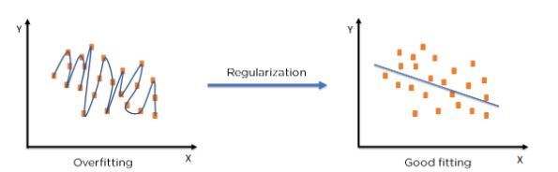
Regularization
Regularization is a method to calibrate machine learning models to reduce the adjusted loss function and prevent over- or underfitting.
Notes:
Image Source link: https://www.analyticsvidhya.com/blog/2022/08/regularization-in-machine-learning/
Instructor notes:
One of the major aspects of training your machine learning model is avoiding overfitting. The model will have a low accuracy if it is overfitting. This happens because your model is trying too hard to capture the noise in your training dataset. By noise we mean the data points that don’t really represent the true properties of your data, but random chance. Learning such data points, makes your model more flexible, at the risk of overfitting.
Regularization
Regularization is a regression technique, which limits, regulates or shrinks the estimated coefficient towards zero. In other words, this technique does not encourage learning of more complex or flexible models, so as to avoid the risk of overfitting.
Regularization is one of the ways to improve our model to work on unseen data by ignoring the less important features.
Regularization minimizes the validation loss and tries to improve the accuracy of the model.
It avoids overfitting by adding a penalty to the model with high variance, thereby shrinking the beta coefficients to zero
Therefore, regularisation may be summed up as a process where we begin with a complex model and go from there. As some of the beta coefficients get smaller in magnitude, almost zero, additional predictors are removed, leaving us with an ideal model that has fewer predictors than the complex model.

Slide 11
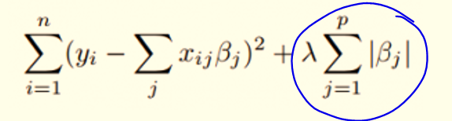
Lasso (L1 Regularization)
Notes:
Image Source link: https://www.statisticshowto.com/lasso-regression/
Instructor notes:
A machine-learning technique called L1 regularisation, often referred to as Lasso regularisation, prevents overfitting by adding a penalty term to the model's loss function depending on the absolute values of the parameters. In order to reduce the number of non-zero parameters in the model (sparse model), L1 regularisation aims to reduce some model parameters towards zero.
Working with high-dimensional data makes L1 regularisation especially helpful because it allows one to select a subset of the most crucial properties. As a result, the likelihood of overfitting is reduced, and the model is also simpler to comprehend. The hyperparameter lambda, which controls the regularisation strength of the L1 regularisation, controls the magnitude of a penalty term. More parameters will be set to zero as lambda increases, enhancing regularisation.

Slide 12
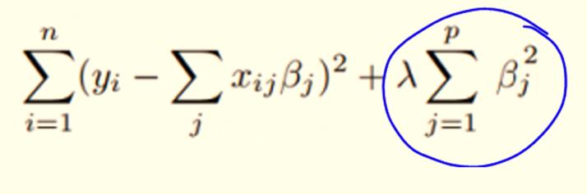
Ridge (L2 Regularization)
Notes:
Image Source link: https://www.statisticshowto.com/lasso-regression/
Instructor notes:
A machine learning technique called L2 regularisation, often referred to as Ridge regularisation, prevents overfitting by adding a penalty term to the model's loss function based on the squares of the model's parameters. The purpose of L2 regularisation is to avoid oversizing and maintain small parameter sizes in the model.
A factor proportionate to the squares of the model's parameters is included in the loss function to accomplish L2 regularisation. The magnitude of the penalty term is controlled by the hyperparameter lambda, which also determines the regularization's strength. The regularisation will be stronger and the parameters will be smaller as lambda increases.

Slide 13
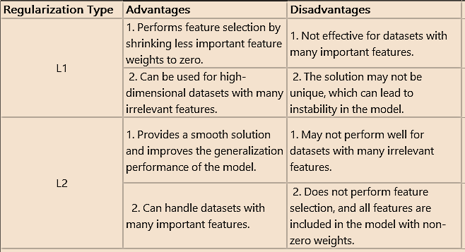
Lasso (L1) v/s Ridge (L2)
Notes:
Image Source link: https://induraj2020.medium.com/how-does-l1-and-l2-regularization-prevent-overfitting-223ef7001042

Slide 14
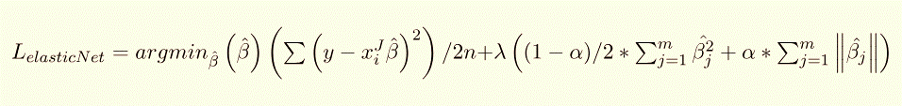
Elastic Net
Notes:
Image Source link: https://www.geeksforgeeks.org/lasso-vs-ridge-vs-elastic-net-ml/
Instructor notes:
Elastic net linear regression regularises regression models by using the penalties from the lasso and ridge procedures. In order to improve the regularisation of statistical models, the strategy combines the lasso and ridge regression models. The lasso approach's drawbacks—namely, the fact that it only needs a few samples for highly dimensional data—are improved by the elastic net method. The inclusion of "n" numbers of variables up until saturation is possible with the elastic net approach. When the variables are grouped into highly correlated groups, lasso usually selects one variable from each group while completely ignoring the others.
The lasso and regression approaches are both used in two stages of the process for determining the estimator of the elastic net method. The second stage is carried out by first locating the ridge regression coefficients and then shrinking the coefficients in a lasso-like fashion.
The coefficients are thus subjected to two different forms of shrinkages using this procedure. Low predictability and high bias are the results of the elastic net's double shrinkage in its naive form. The coefficients are scaled by multiplying them by (1+λ2) to account for these impacts.

Slide 15
Demo

Slide 16
SUMMARY
Linear regression models are high-bias models
Regularization is a method to introduce variance in the models in order to reduce bias using a penalty term (lambda)
Regularization helps overcome the complications of overfitting and underfitting
Lasso (L1) tends to make coefficients to absolute zero
Ridge (L2) only minimizes coefficients
Elastic Net combines the penalties of both L1 and L2

Slide 17



